Slide 1
Medical Information Retrieval System
Patrick Mc Connell
Supervisor: Dr.Liadh Kelly

Slide 2
Contents
1. Introduction
2. Background Research
3. The Problem
4. The Solution
5. Evaluation
6. Conclusion

Slide 3
Introduction
Motivation:
This projects set out to investigate the use of low benchmark algorithms used in medical information retrieval.
Identify stronger baselines for information retrieval for different languages.
Goals:
Create an document index of medical documents.
Translate queries into English to search the index.
Test different retrieval algorithms over different languages.
Conduct evaluation on the different algorithms over the different languages.

Slide 4
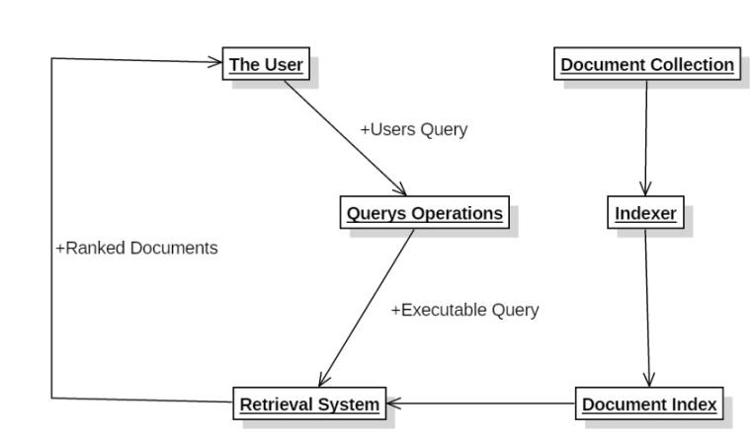
Information Retrieval Architecture
The User: Medical query is posed.
Query Operations: where the query cleansing is done.
Document Collection: The medical documents used.
Indexer: Converting the documents into an Inverted Index.
Document Index: This is the Inverted index of documents.
Retrieval system: Gathers documents that are relevant to the query via relevant algorithm.

Slide 5
Background Research
CLEF eHealth tasks have been running since 2013.
Each year tasks in IR are offered to participants to evaluate systems that support laypeople in searching for and understanding health information.
Collection consists of over 1 million medical documents.
67 different medical queries.
~75% of all medical documents readily available on the web are written in English.
60-70% of the medical documents adhere to the HONcode (Health on the net).

Slide 6
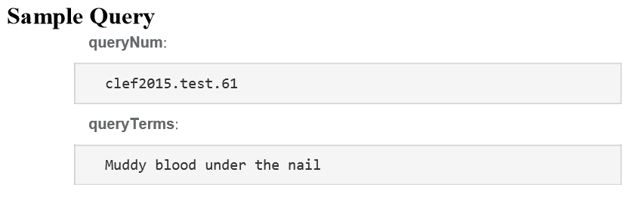
The Problem
Low benchmark algorithms for medical information retrieval.
It is difficult to retrieve information when translating the query to English to search English medical documents.
Medical Diction poses a problem for searching complicated symptoms.
Persian Query

Slide 7
The Solution
Preparing the data.
Removing the XML tags from the queries.
Translating the queries.
Translation of queries into English with Google Translate.
Creating the index.
Use of Lucene library to create an inverted index.
Stemming of queries and index documents.
Porter stemming used to remove suffix's of words.
Eg. Bike, bicycle, bicycling reduces to Bike as its root word.
Results generation for the different retrievals.
Use of different retrieval algorithms.
VSM, BM25, Dirichlet Smoothing.
Store in a database.
Trec_Eval used for results analysis.
Compared against a handmade relevance judgement to receive its scoring on different metrics.
Precision and Normalized Discounted Cumulative Gain at top 5 and 10 documents was used.

Slide 8
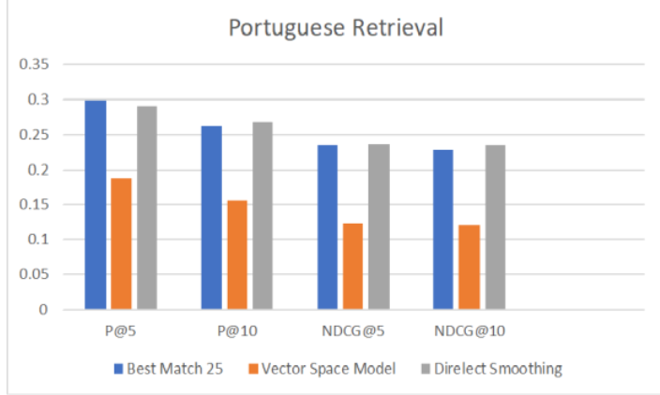
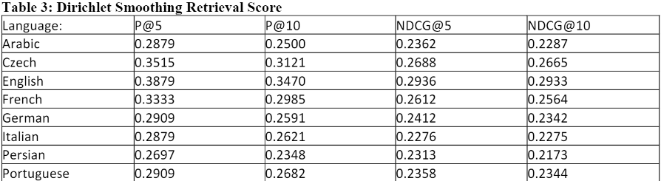
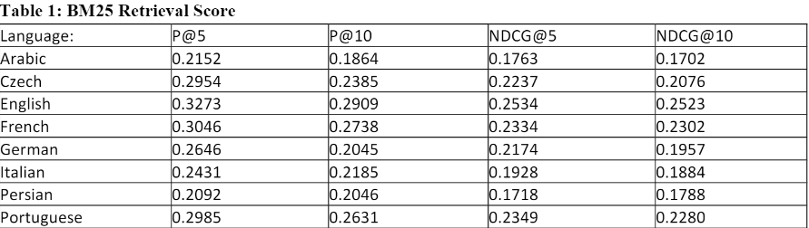
Evaluation
Programming language R was used to conduct the Wilcoxon Signed Rank test evaluate statistical significance.
4 metrics are used, Precision and Normal Discounted Cumulative Gain at top 5 and 10 documents.
Dirichlet Smoothing approach proves better than VSM and BM25 overall.
Portuguese proves an interesting case. BM25 is stronger in top 5 documents for precision but weaker elsewhere.

Slide 9
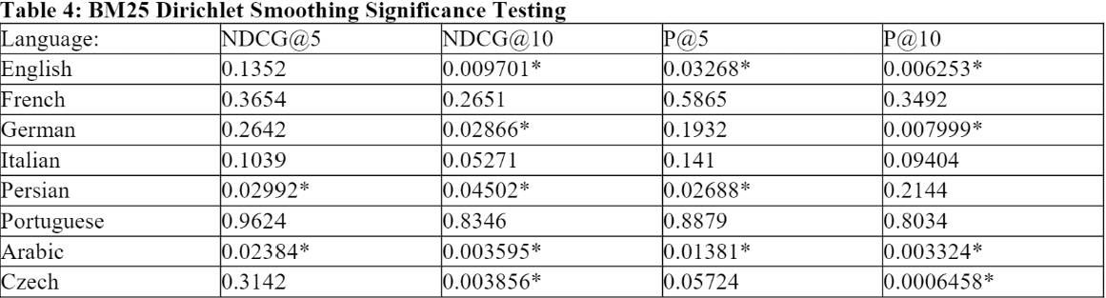
Conclusion
Dirichlet Smoothing provided the best retrieval from the 3 evaluated algorithms.
There is a need for use of strong benchmark algorithms especially in medical information retrieval.
There is no one algorithm that is always strongest over different languages.

Slide 10
Questions?

Slide 11
Thank You!

